Slide 1
Chemical Bonds: The Formation of Compounds from Atoms
Chapter 11

Slide 2
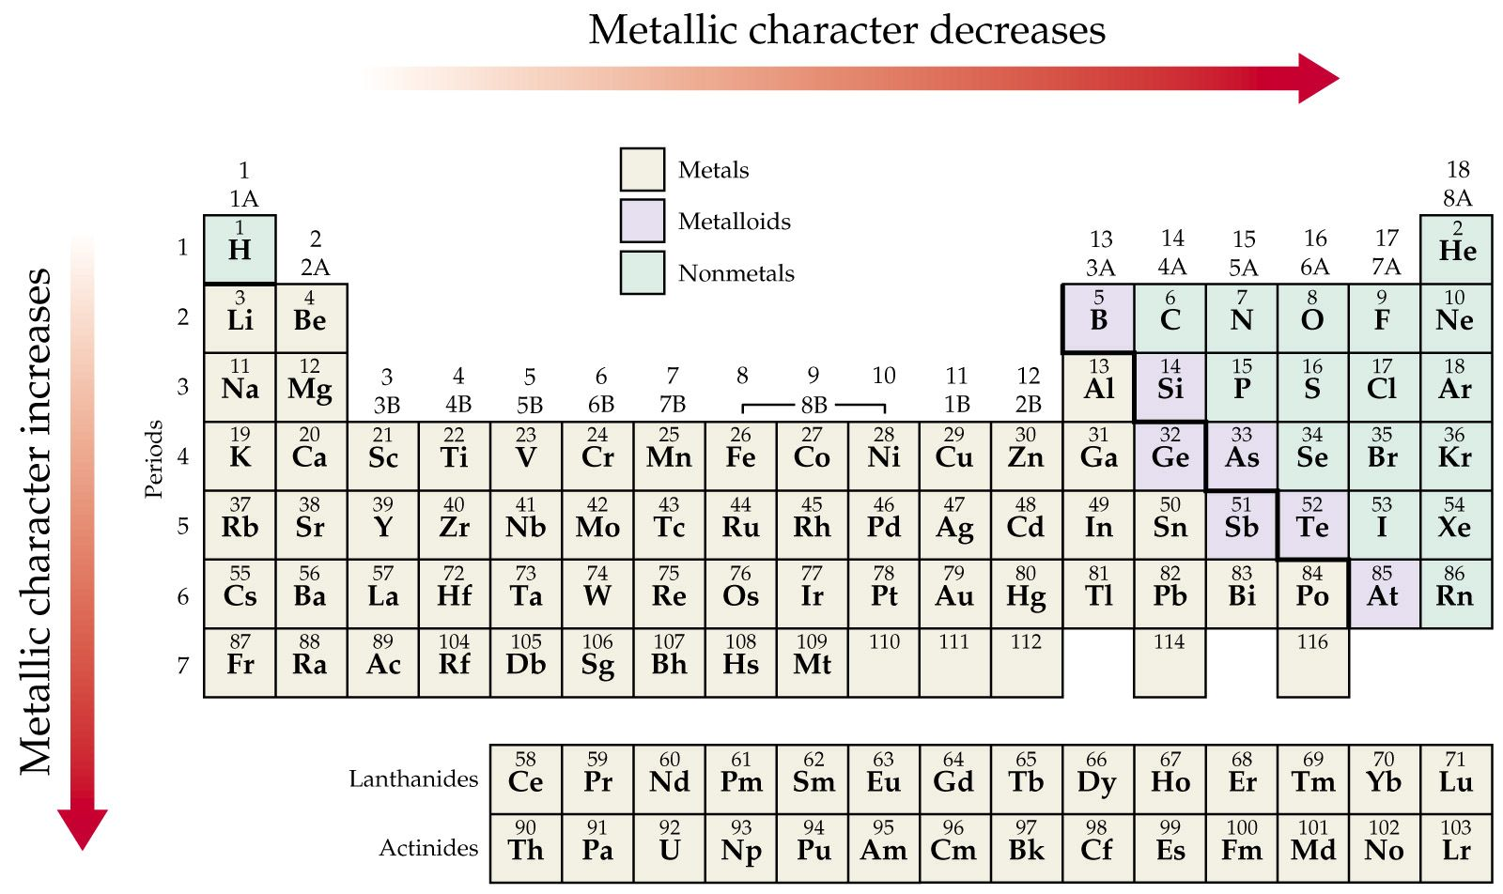
Periodic Properties
Metallic Character

Slide 3
Notes:
Figure: 08-18
Title:
Trends in Metallic Character II
Caption:
As you move down group 5A in the periodic table, metallic character increases. As you move across period 3 in the periodic table, metallic character decreases.

Slide 4
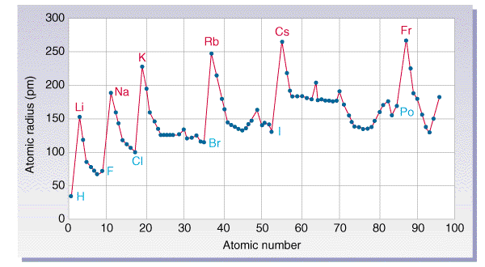
Periodic Properties
Atomic Size – determined by how far the outermost electrons are from the nucleus

Slide 5
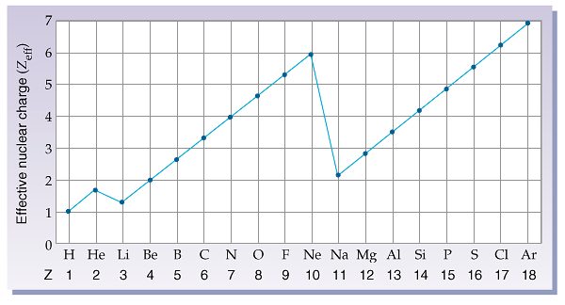
Effective nuclear charge

Slide 6
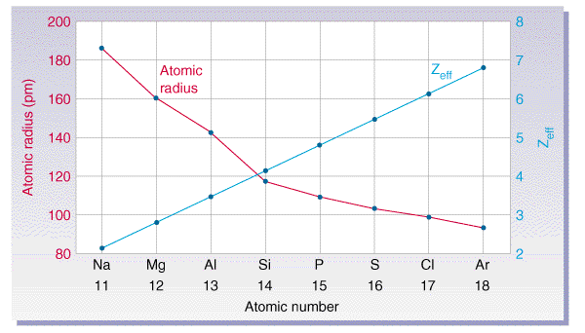

Slide 7
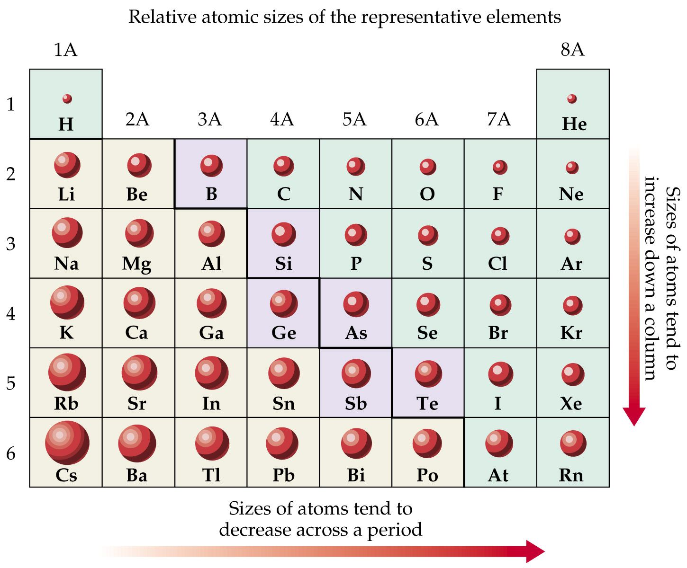

Slide 8
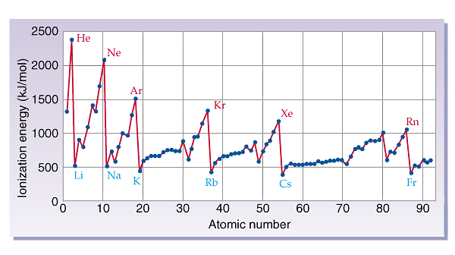
Periodic Properties
Ionization Energy - The amount of energy required to remove the outermost electron form an isolated neutral atom in the gaseous state.

Slide 9
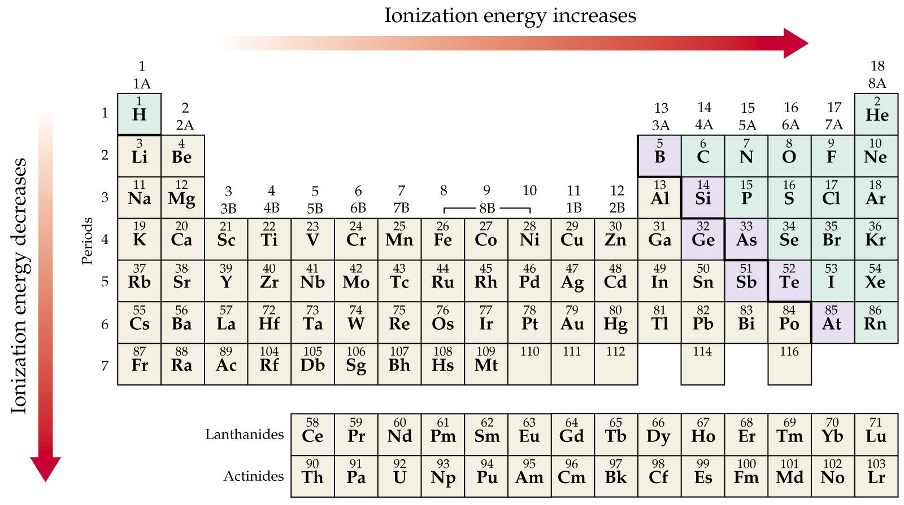

Slide 10
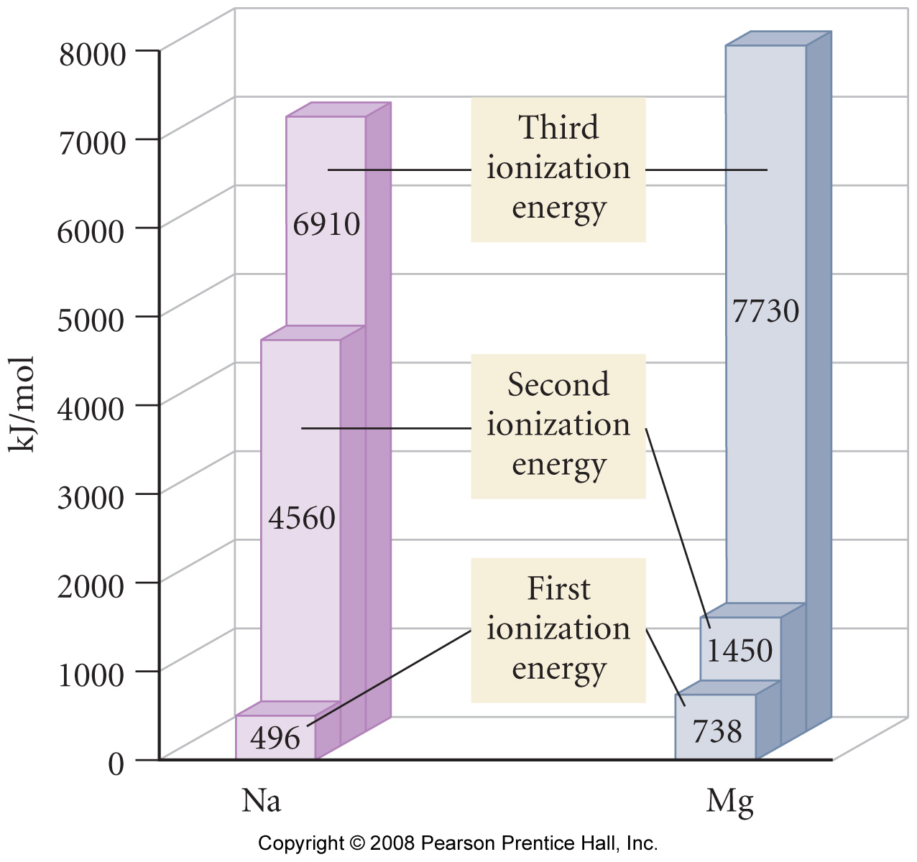
Notes:
Figure: 08-15-06UN
Title:
First, second and third ionization energies
Caption:
Why is the huge jump in Na between the first and second energies, while the huge jump in Mg is between the second and third ionization energies?

Slide 11
Higher ionization energies
Ionization energy always increases as you pull off more electrons.
Ionization energies take a huge leap when we try to remove an electron from a new inner shell.

Slide 12
Electron Affinity
The energy change that occurs when an electron is added to an atom (or ion) in the gaseous state. Frequently costs nothing but actually yields energy therefore EA’s are usually negative.

Slide 13
Valence Electrons
The electrons that occupy the outermost s and p orbitals of an atom

Slide 14
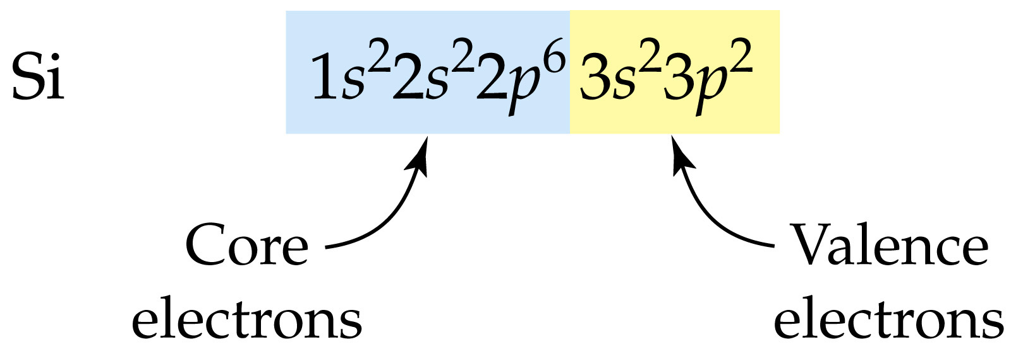
Notes:
Figure: 09-27-05un
Title:
Silicon's valence electrons

Slide 15
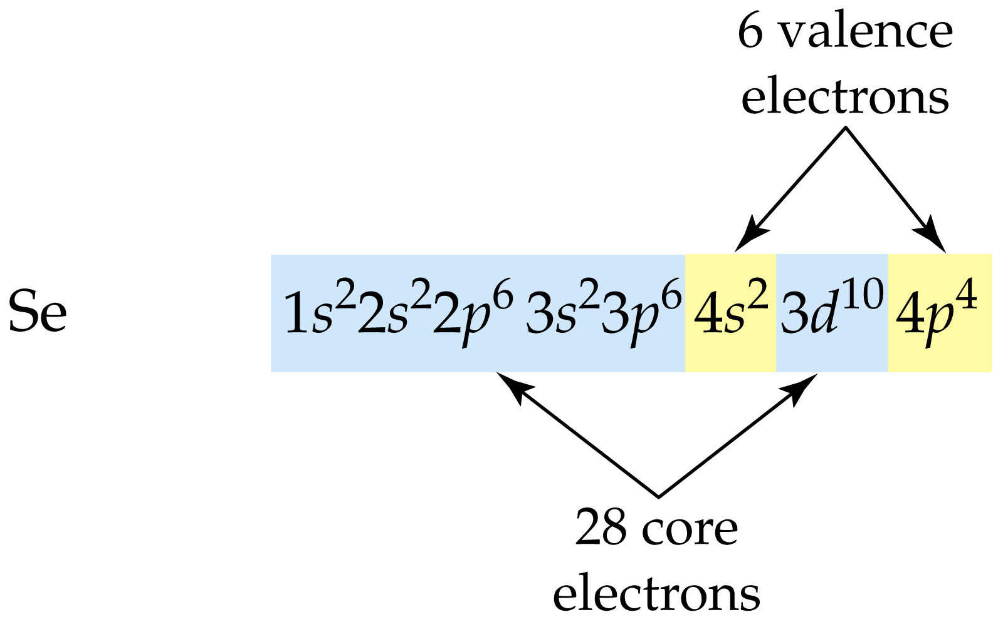
Notes:
Figure: 09-27-06un
Title:
Selenium's valence electrons

Slide 16
Notes:
Figure: 09-32
Title:
The noble gases have filled valence subshells

Slide 17
Electronic Configuration of the Ions
Cations - Electrons are removed from the highest energy occupied orbital
Anions - Electrons are added to the lowest energy unoccupied orbital
For transition metals -- The highest ns electrons are removed first (even though they are not the last added)

Slide 18
Notes:
Figure: 08-11-08UN
Title:
EXAMPLE 8.6 Electron Configurations and Magnetic Properties for Ions (a)
Caption:
Write the electron configuration and orbital diagram for each of the following ions and determine whether the ion is diamagnetic or paramagnetic.
(a) Al³⁺ (b) S²⁻ (c) Fe³⁺

Slide 19
Isoelectronic
Isoelectronic species have the same electron configuration.
Atoms tend to gain or lose electrons to become isoelectronic with noble gases
Ne 1s² 2s² 2p⁶
Na⁺¹ 1s² 2s² 2p⁶
F⁻¹ 1s² 2s² 2p⁶

Slide 20
Ionic Radii
Cations -- radius decreases due to an increase in Zeffective
Anions -- radius increases due to crowding of more electrons into a shell

Slide 21
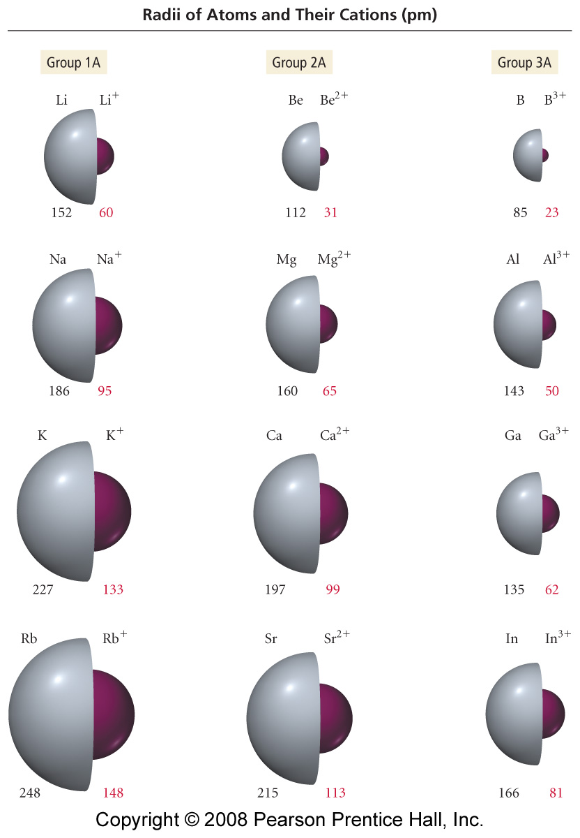
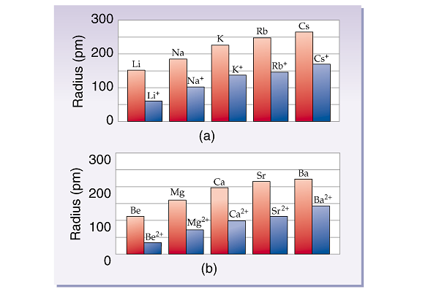
Notes:
Figure: 08-12
Title:
Sizes of Atoms and Their Cations
Caption:
Atomic and ionic radii (pm) for the first three columns of main-group elements.

Slide 22
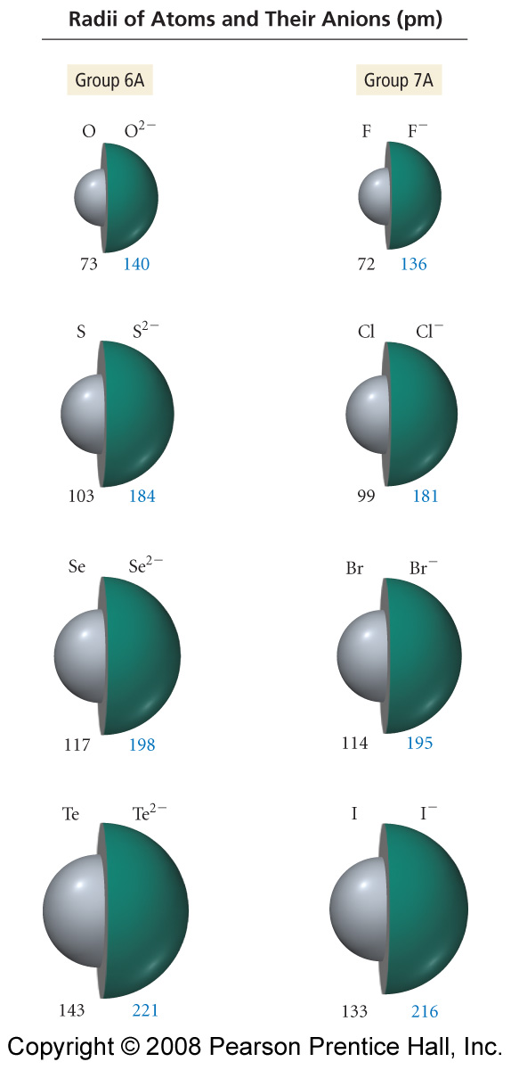
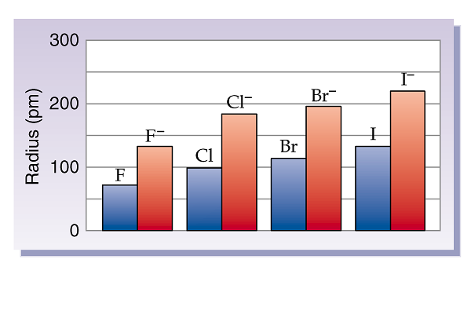
Notes:
Figure: 08-13
Title:
Sizes of Atoms and Their Anions
Caption:
Atomic and ionic radii for groups 6A and 7A in the periodic table.

Slide 23
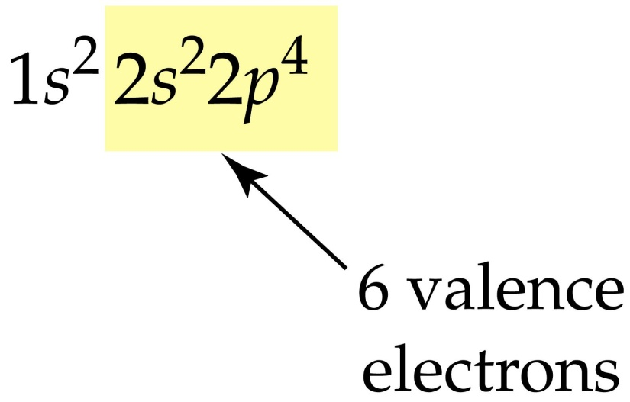
Lewis Electron Dot Structures
For elements
Composed of elemental symbol + dots representing the outer shell or valence electrons
For oxygen --

Slide 24
Lewis Electron Dot Structures
For ions
Add or subtract dots for electrons gained or lost to form ion.
For O²⁻ –
1s²2s²2p⁶

Slide 25
Bonding
Atoms like to have a full outer shell and will gain lose or share electrons to achieve a full outer shell
Representative elements gain, lose, or share electrons to have 8 electrons in their outer shell corresponding to full s and p orbitals.
This is the octet rule.

Slide 26
Two kinds of bonds
Ionic
atoms gain or lose electrons to form octet
ions held together by electrostatic forces
Covalent
atoms share electrons to form octet
atoms held together by shared electron covalent bonds

Slide 27
Ion Formation
Cations
Na → Na⁺ + 1e⁻
Mg → Mg⁺² + 2e⁻
Anions
Cl + 1 e⁻ → Cl⁻¹
S + 2 e⁻ → S⁻²
These elements tend to lose electrons to gain an octet
Note: losing an electron always costs energy -- but sometimes this lost of energy can be compensated by the strong electrostatic energy gained when a cation and an anion combined.
These elements tend to gain electrons to form an octet

Slide 28
Ionic Bonds
Bonds formed by the interaction of ions and the strong electrostatic forces that hold them together.
Ions group together in ratios which balance their positive and negative charges → results in a neutral crystal

Slide 29
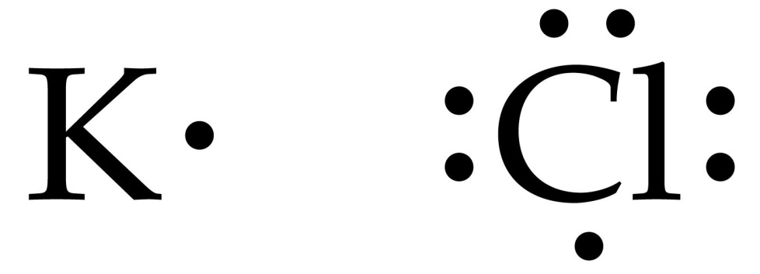
What compound will be formed by the reaction of potassium and chlorine?

Slide 30
What compound will be formed by the reaction of magnesium and oxygen?

Slide 31
What compound will be formed by the reaction of sodium and sulfur?

Slide 32
What compound will be formed by the reaction of sodium and sulfur?

Slide 33
Covalent Bonds
Bonds where atoms share electrons to achieve an optimum number of electrons in their outer shells. Typically an octet.

Slide 34
Show bonding in H₂
+

Slide 35
Show bonding in Cl₂
+

Slide 36
Show bonding in O₂
+

Slide 37
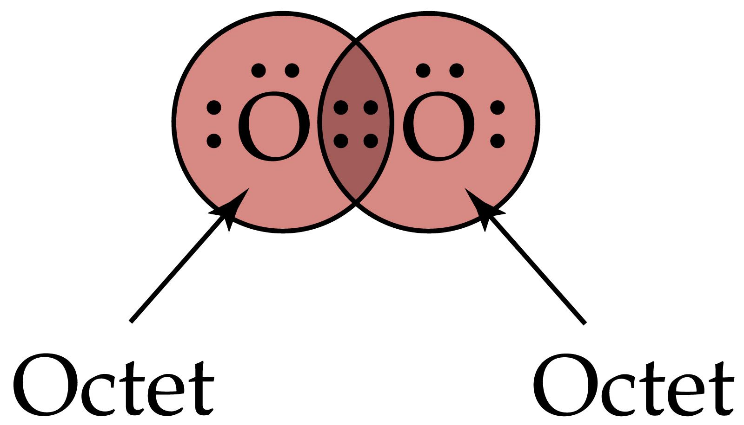

Slide 38
Show bonding in N₂

Slide 39
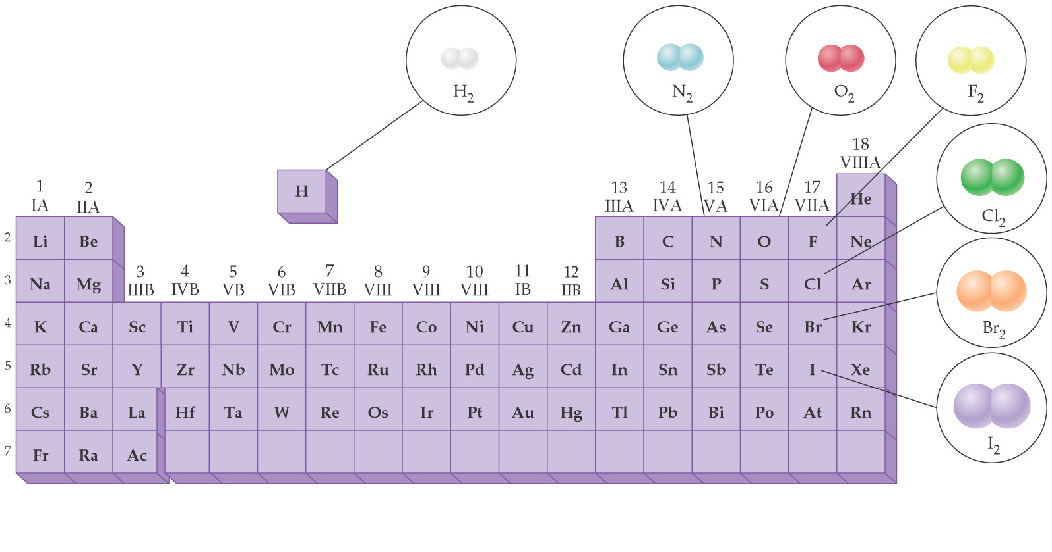
Diatomic Elements

Slide 40
Bond Length
Bond Strength
A measure of the amount of energy it takes to break a bond.
The length of a bond between two atoms is the distance separation the nuclei of the atoms.

Slide 41
Bonding in nonmetals
Generally every unpaired electron in the Lewis Dot diagram of an element can form a bond.

Slide 42
Bonding in nonmetals
Generally every unpaired electron in the Lewis Dot diagram of an element can form a bond.

Slide 43
Lewis Electron Dot Structures
Bonding electrons pairs – electron pairs involved in bonds
Lone electron pairs – electron pairs that do not participate in bonding
Bond order = number of bonds

Slide 44
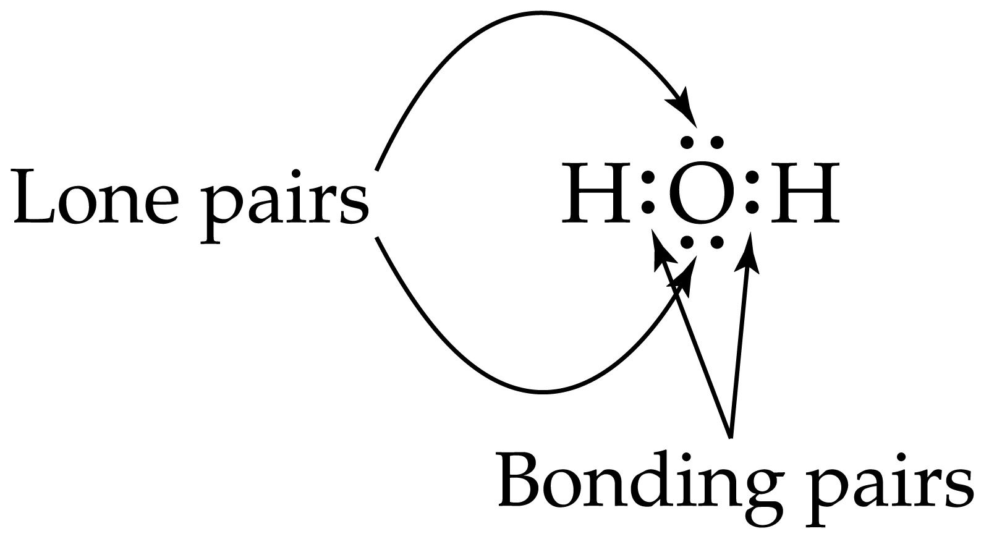
+
+
or

Slide 45
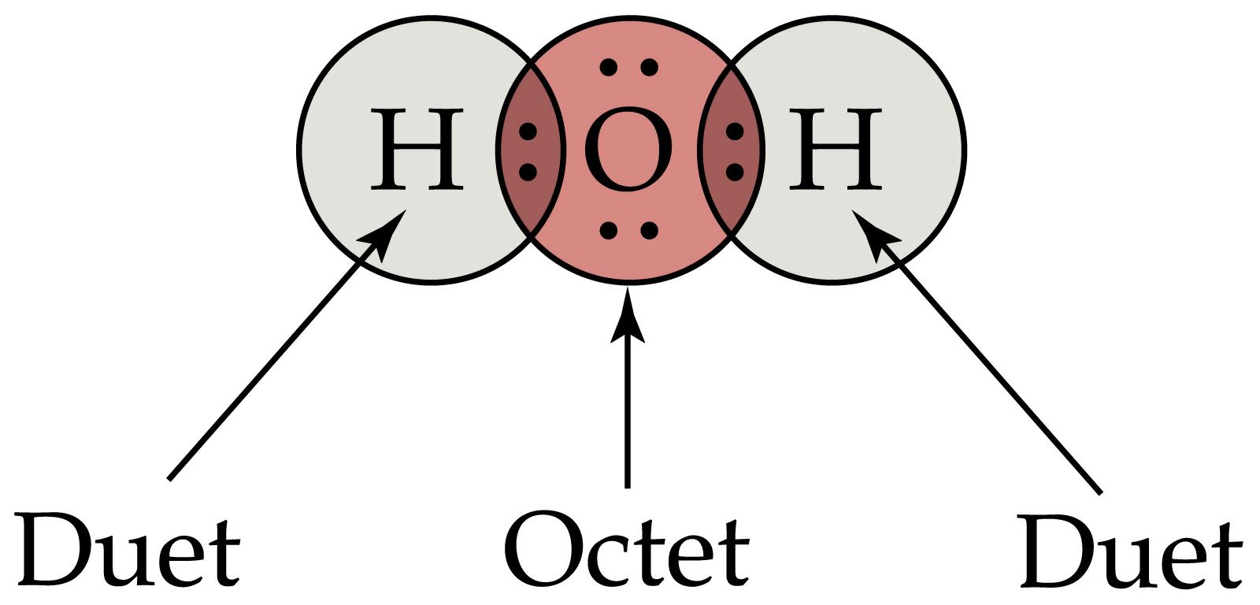

Slide 46
Writing Lewis Dot Structures
Decide which atoms are bonded together - draw a skeleton structure
Count the total number of valence electrons available.
Find the number of electrons needed to give an octet around all atoms -- (remember H needs 2, all else need 8).

Slide 47
Writing Lewis Dot Structures
Determine number of electrons short.
Number of bonds needed = number of electrons short/2.
Distribute bonds -- (1st hook atoms together and then add double bonds where appropriate).
Calculate number of electrons used in bonds.

Slide 48
Writing Lewis Dot Structures
Calculate electrons remaining.
Distribute remaining electrons to give all atoms an octet.
Done!!

Slide 49
Lewis Structures of ions
for anions add the extra electrons to the number available
for cations subtract the lost electrons from the number available

Slide 50
Resonance
In some Lewis structures, the multiple bonds can be written in several equivalent locations. All structures have the exact same energy. Which is the correct Lewis structure??
Answer : None alone are correct – the true molecule is a hybrid of the possible structures. The electrons are delocalized.

Slide 51
Predicting Shapes of Molecules
To predict the shapes of molecules we look at the things (sigma bonds or lone pairs of electrons) surrounding them and put them as far from each other as possible.
Valence Shell Electron Pair Repulsion (VSEPR) Theory

Slide 52
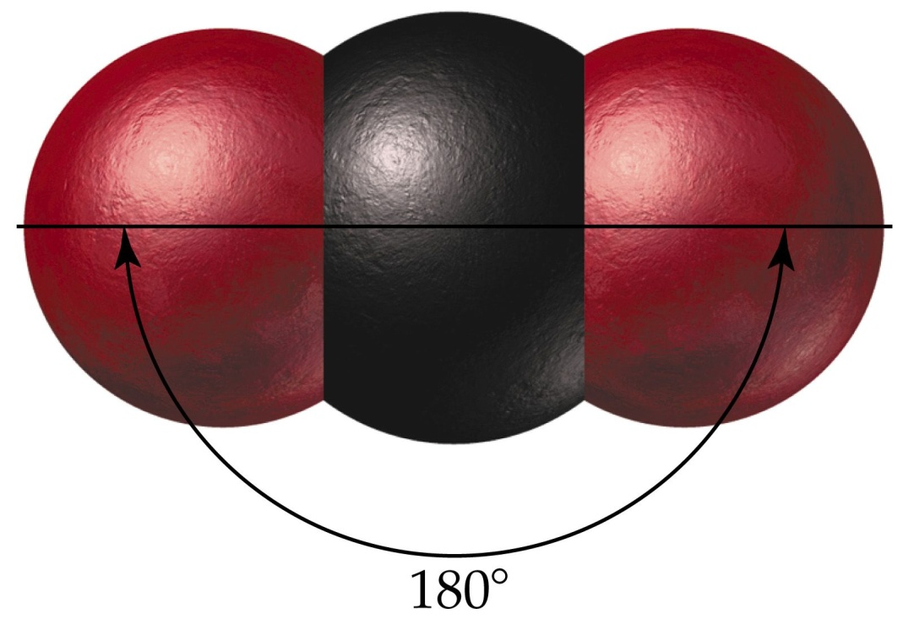
2 atoms attached to central atom

Slide 53
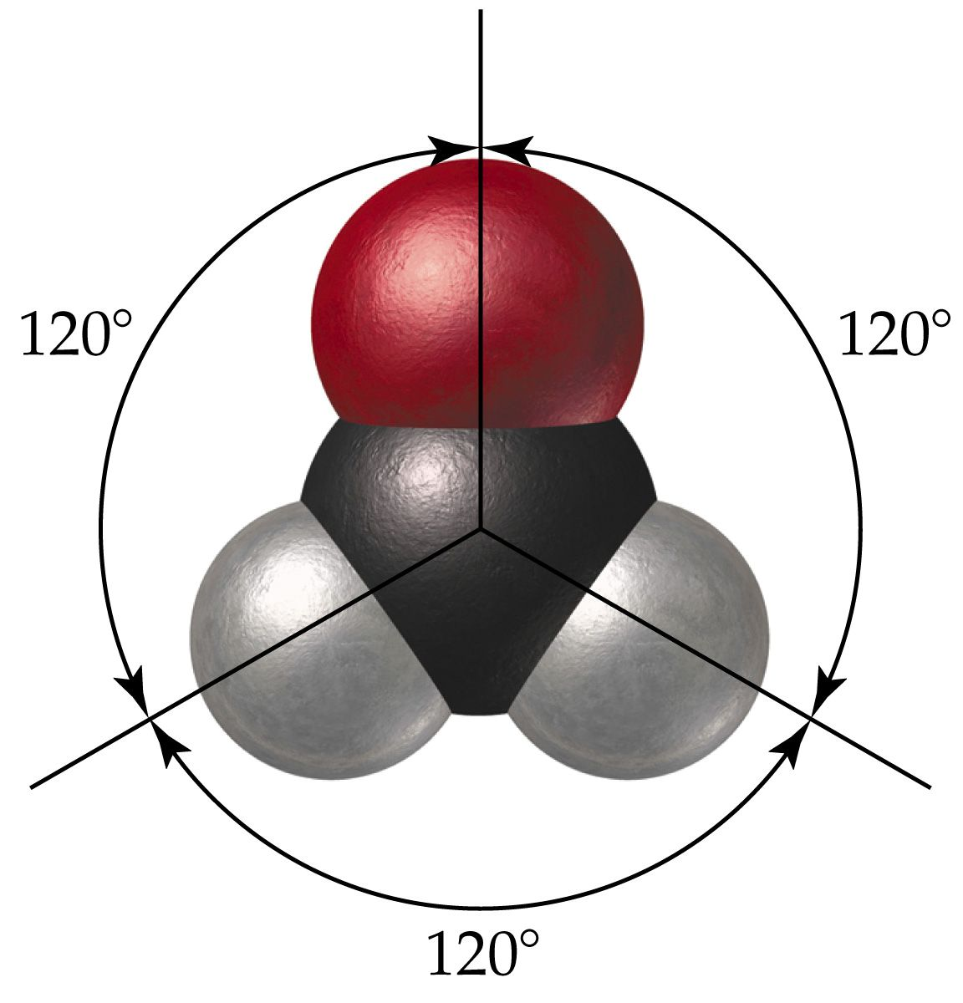
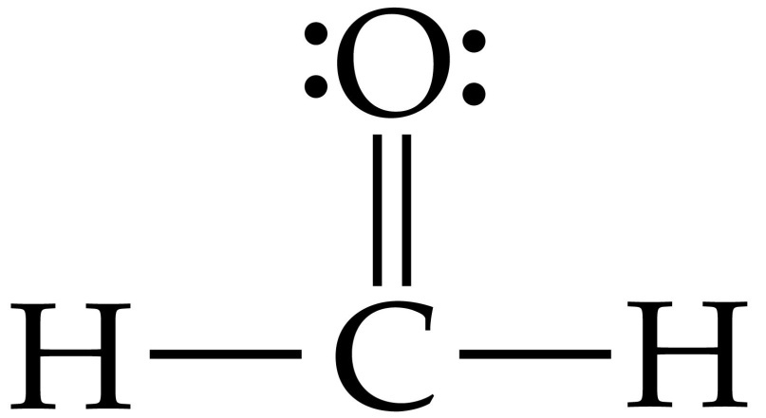
3 atoms attached to central atom

Slide 54
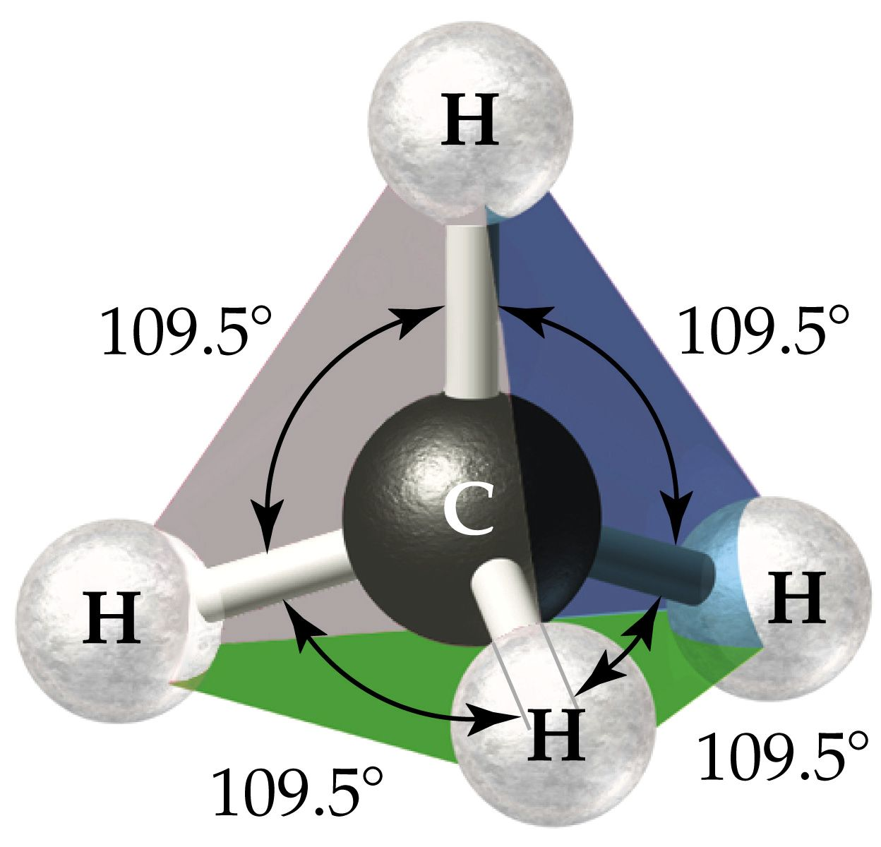
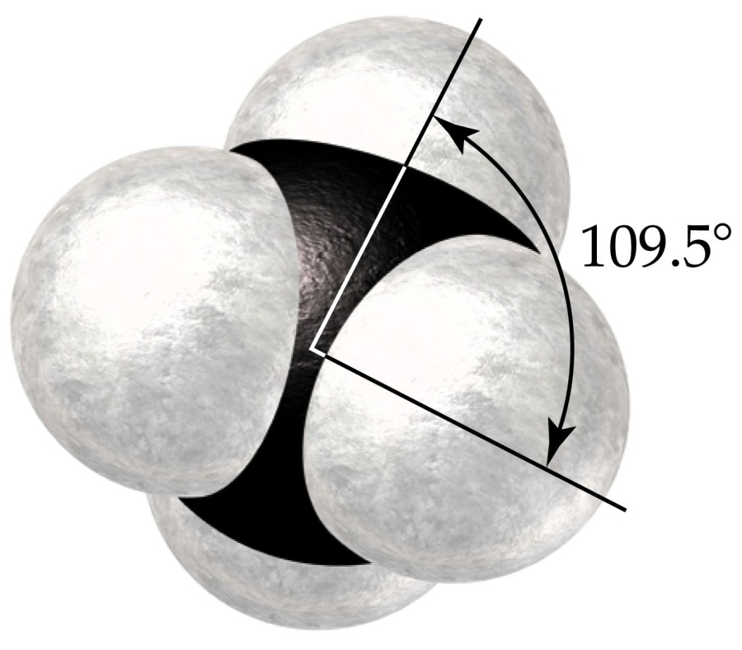
4 atoms attached to central atom

Slide 55
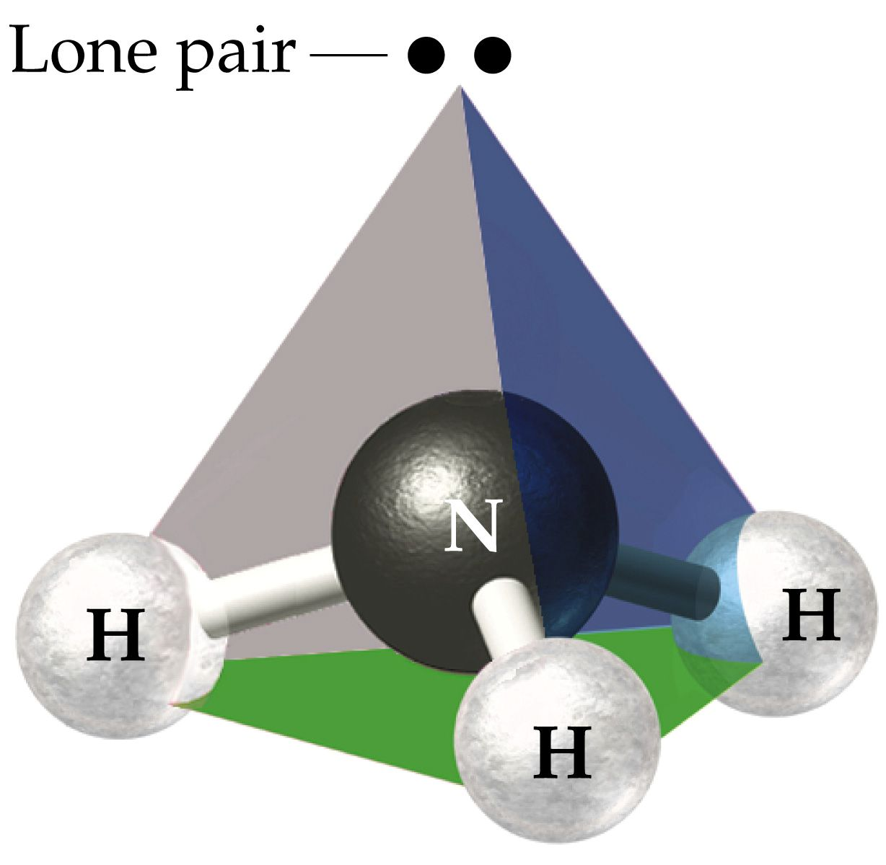
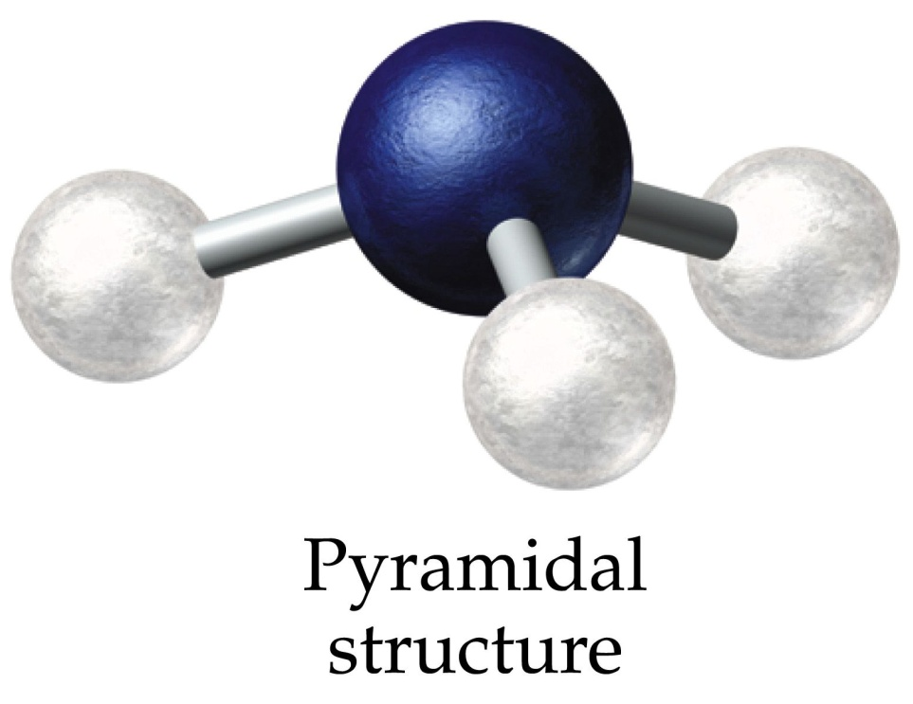
3 atoms + lone pair attached to central atom

Slide 56
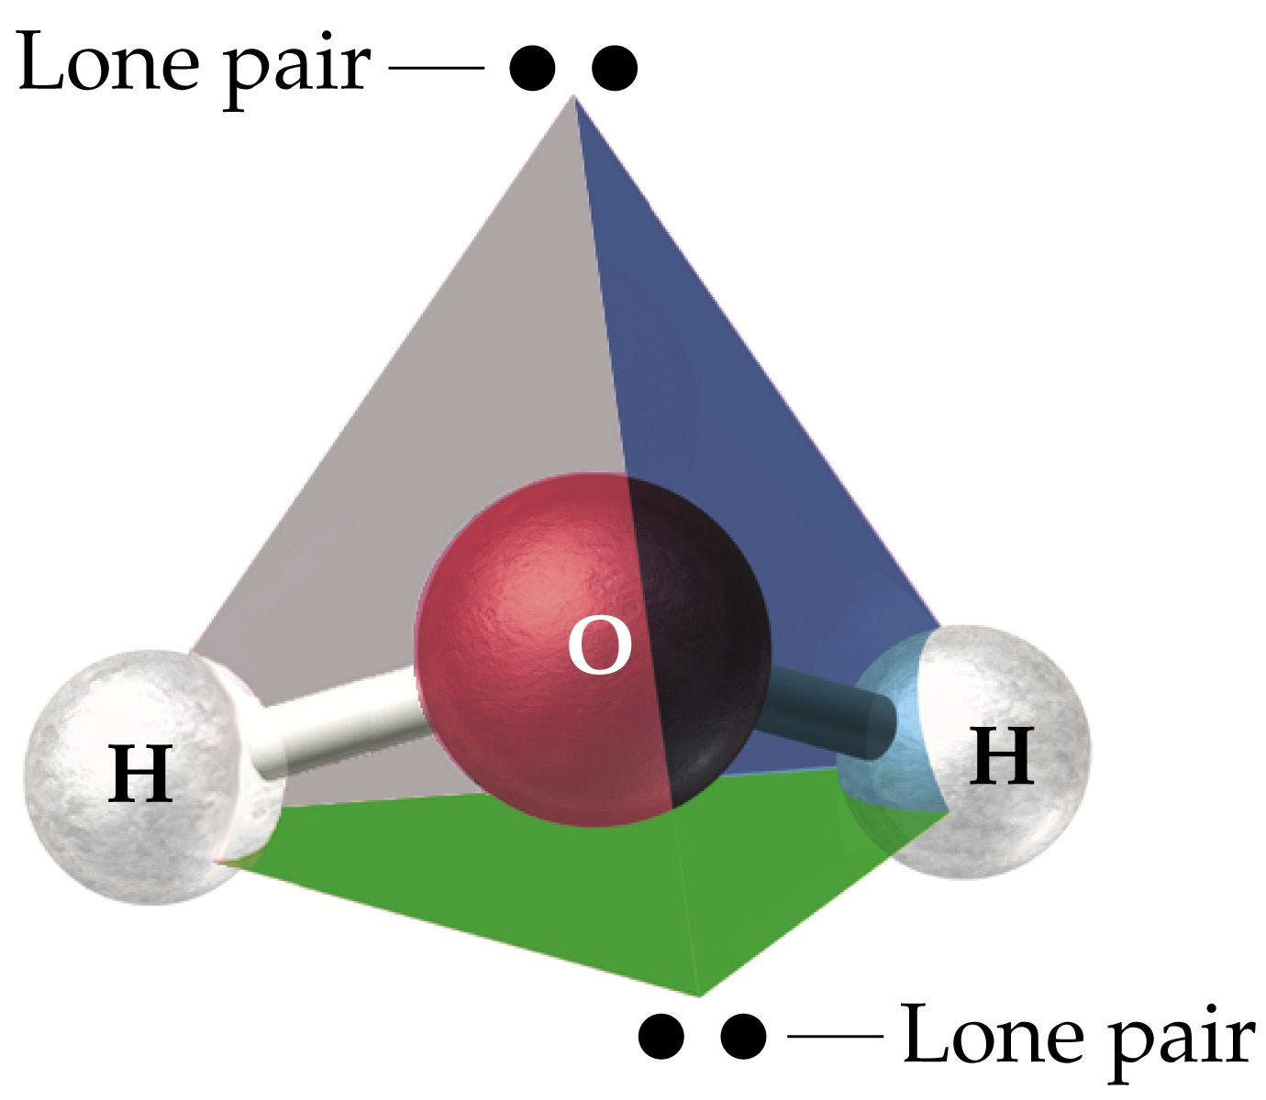
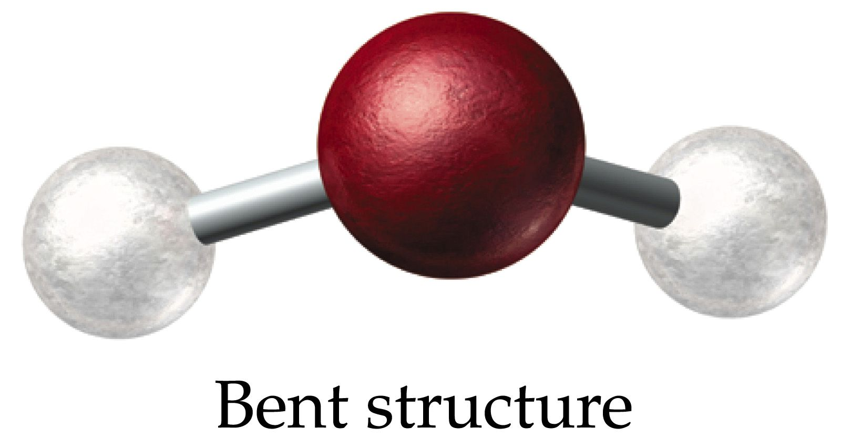
2 atoms + 2 lone pairs attached to central atom

Slide 58
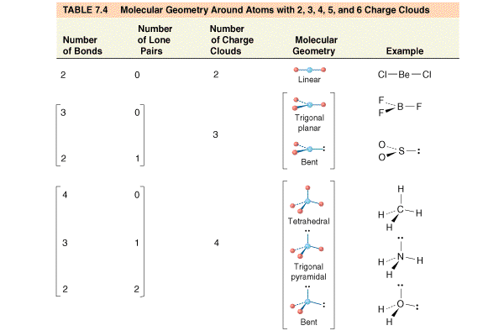

Slide 59
Electronegativity
A measure of the relative tendency of an atom to attract electrons to itself when it is bonded to another atom.
“Electron Greed”
Electronegativity increases up and to the right on the periodic table.

Slide 60
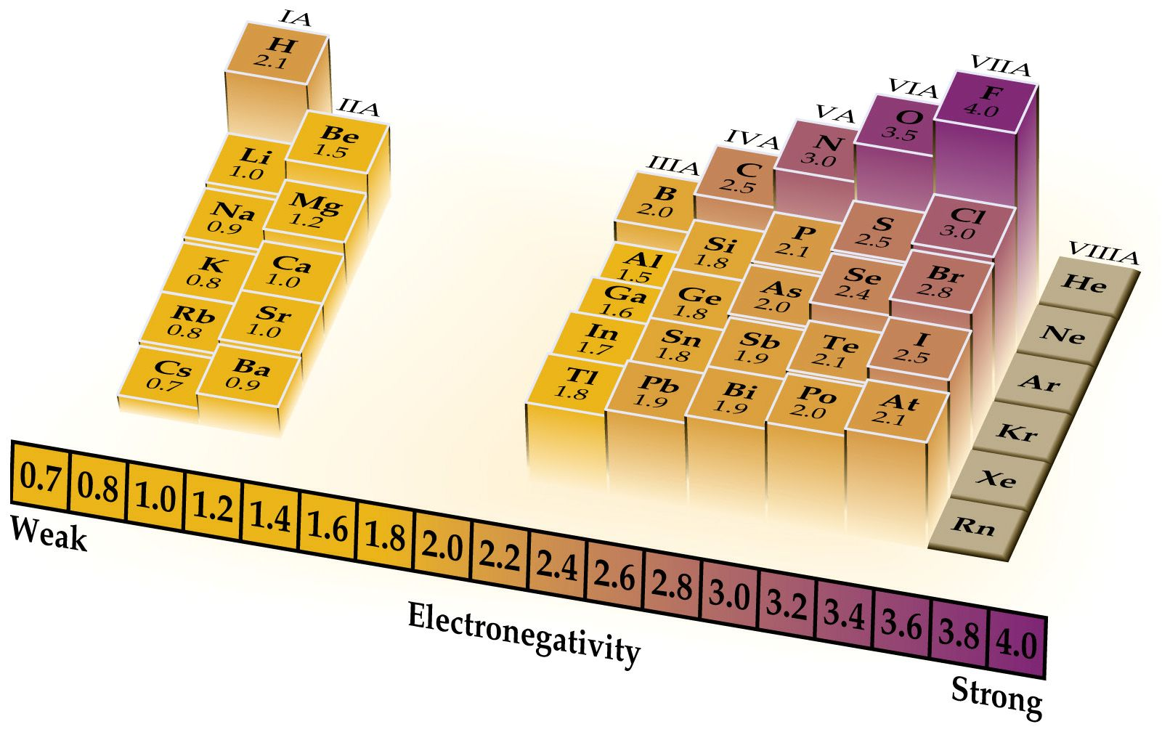

Slide 61
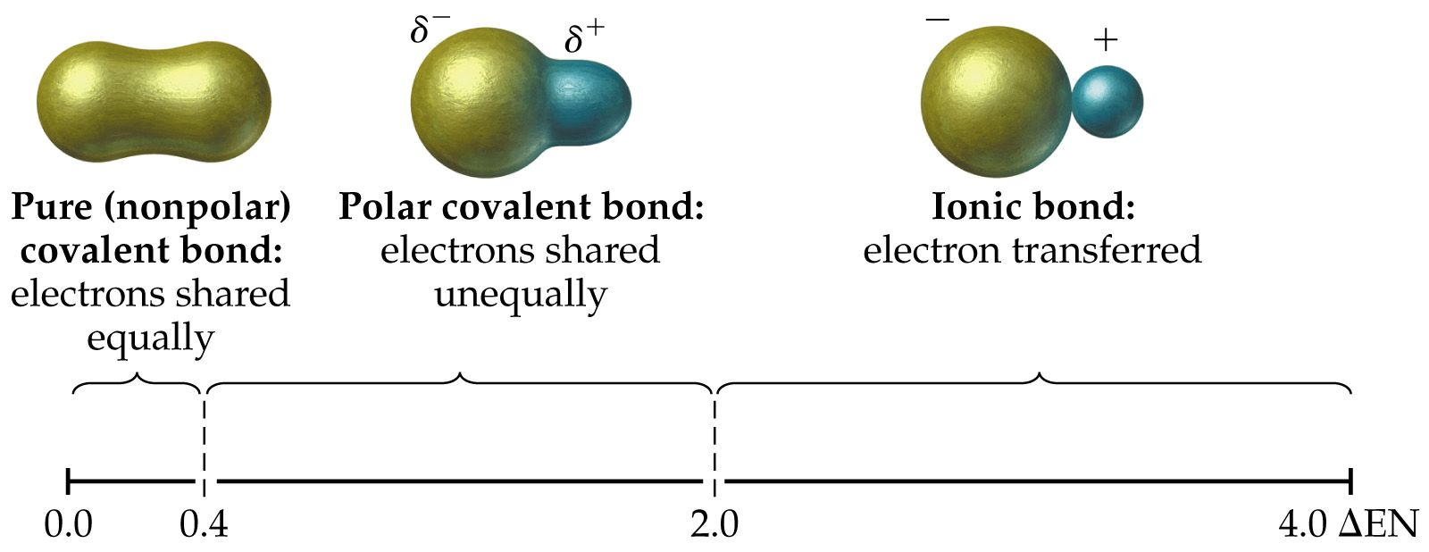
Polar Bonds
Bonds in which electrons are not shared equally due to the electronegativity differences.

Slide 62
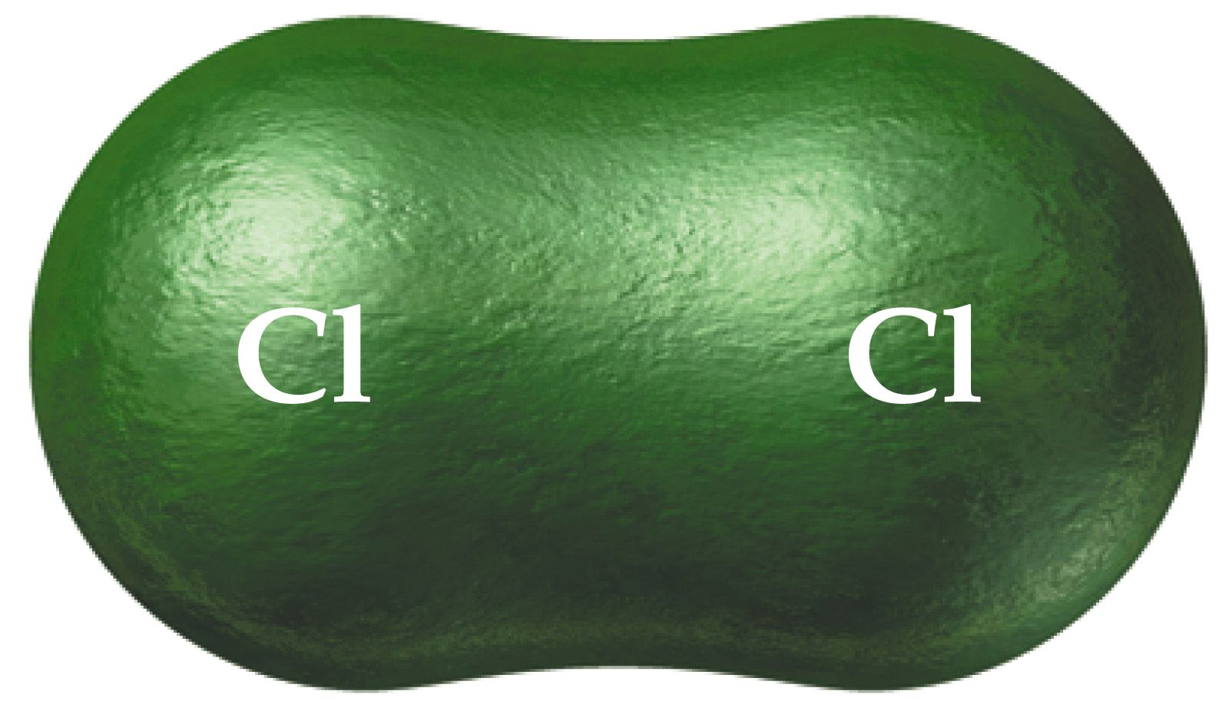
Cl₂

Slide 63
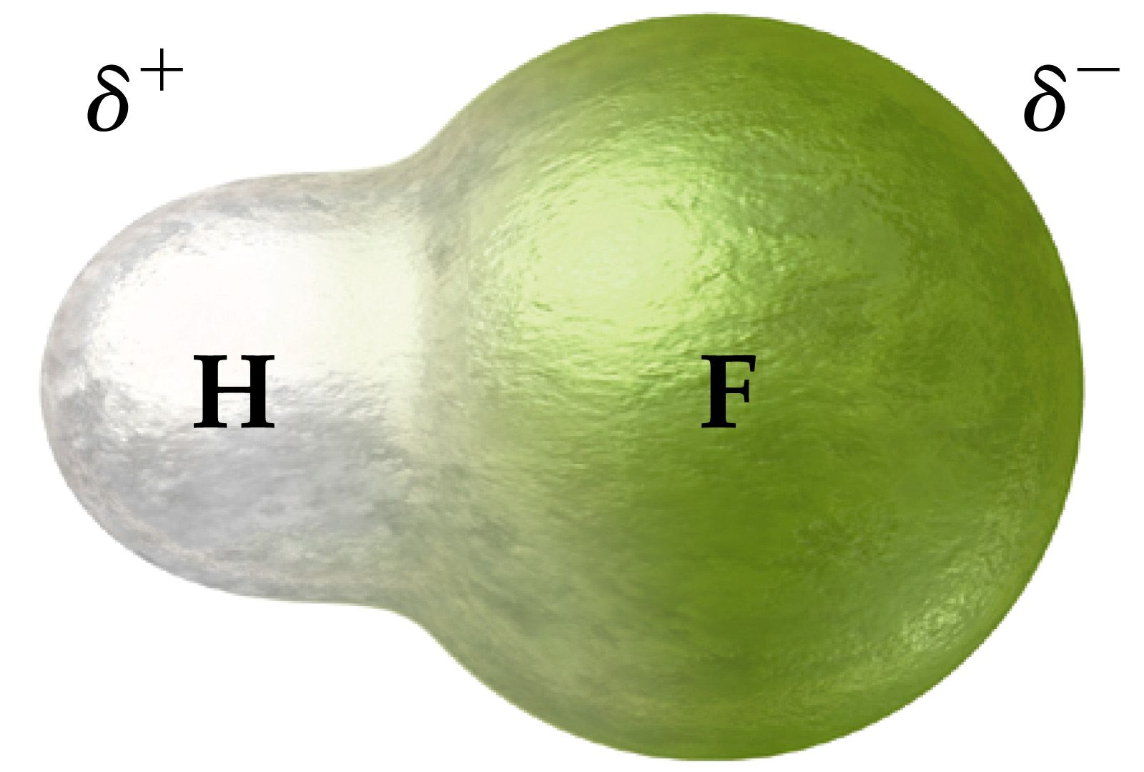
HF

Slide 64
Polar molecules
Molecules with a positive and negative end due to the presence of polar bonds.

Slide 65
Polar Molecules
Dipole - A molecule such as HF which has a positive and a negative end. This dipolar character is often represented by an arrow pointing towards the negative charge.
Dipole moments – the measure of the net molecular polarity
Measured in units of Debyes (D) = Qr (charge x separation)

Slide 66
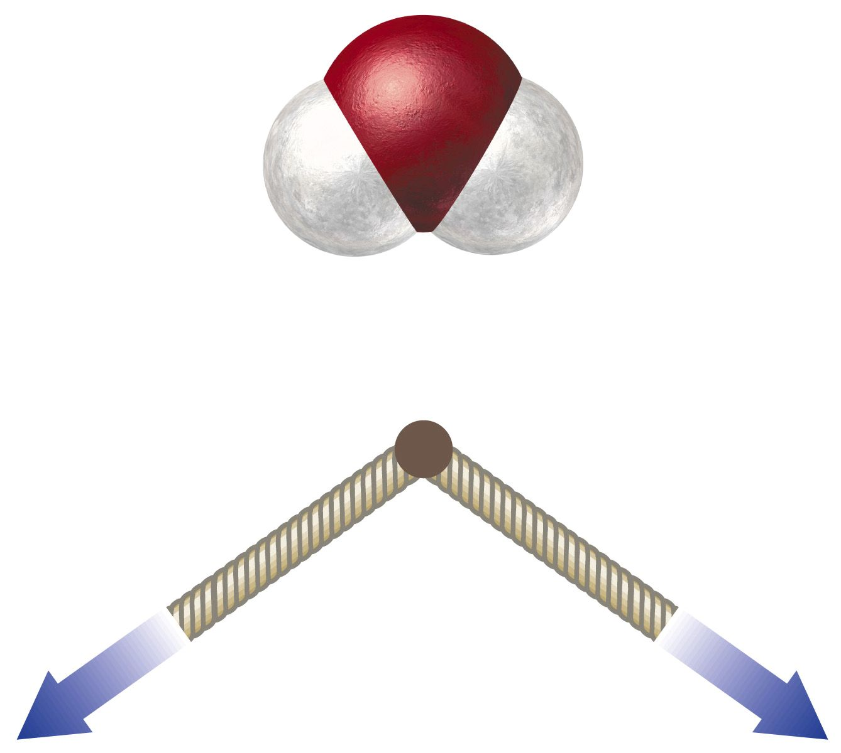
H₂O

Slide 67
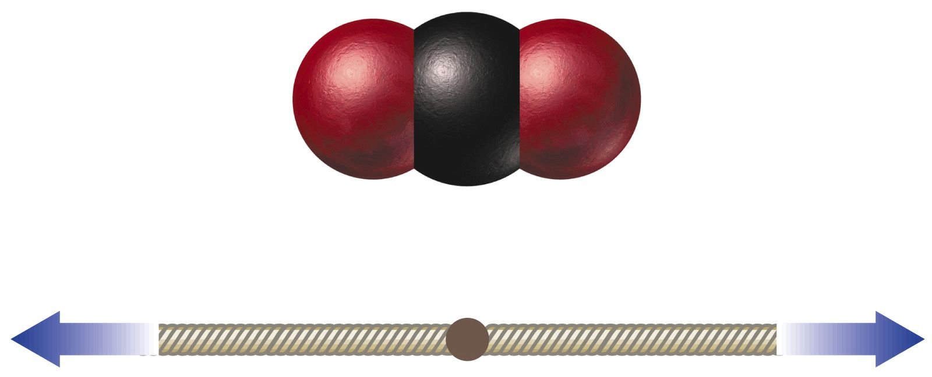
CO₂

